Slide 1

Hubble Diagram Reproduction
Mykola Chernyashevskyy

Slide 2
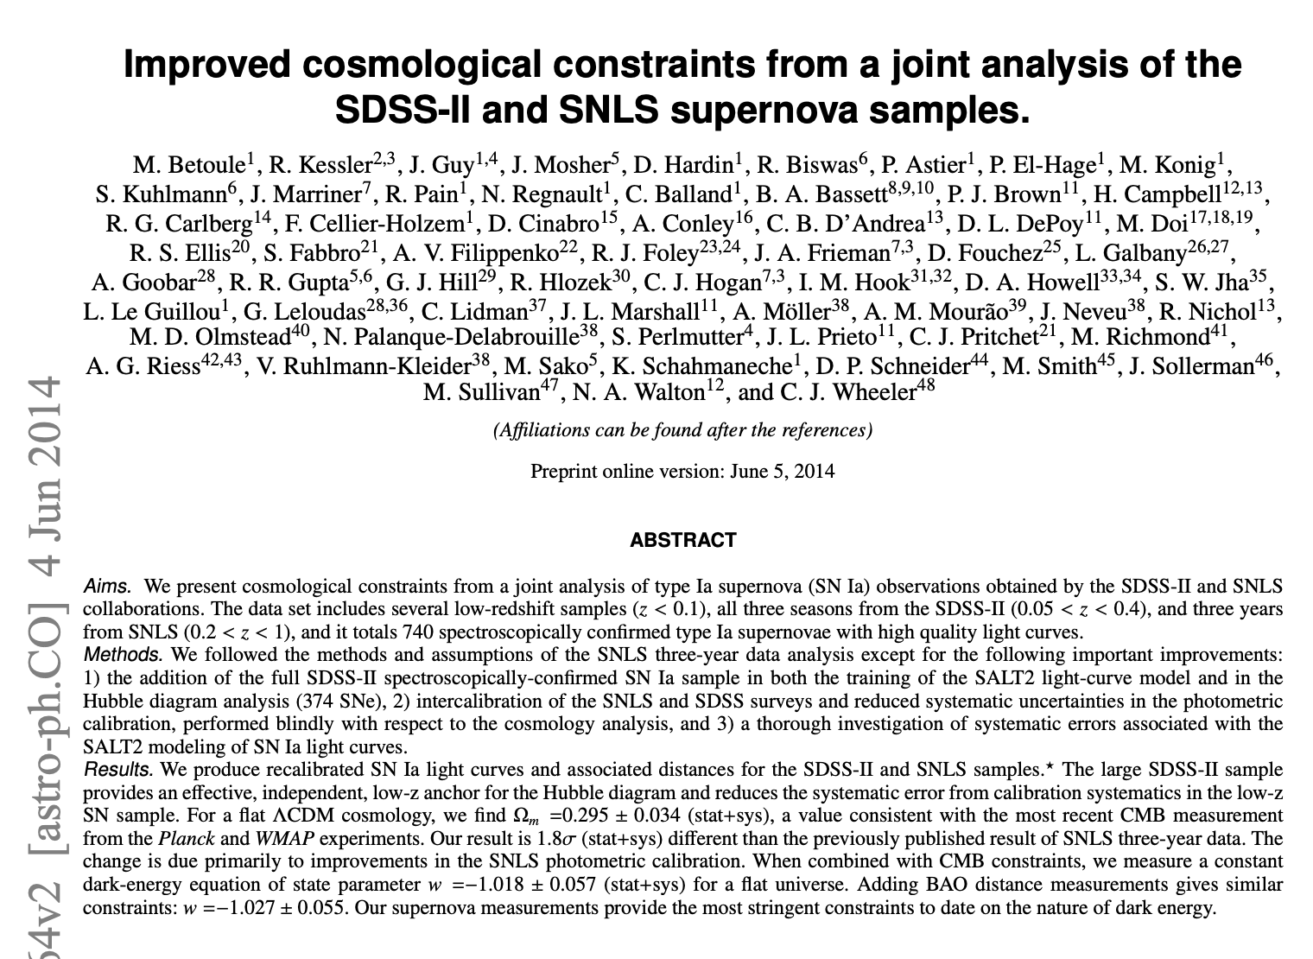
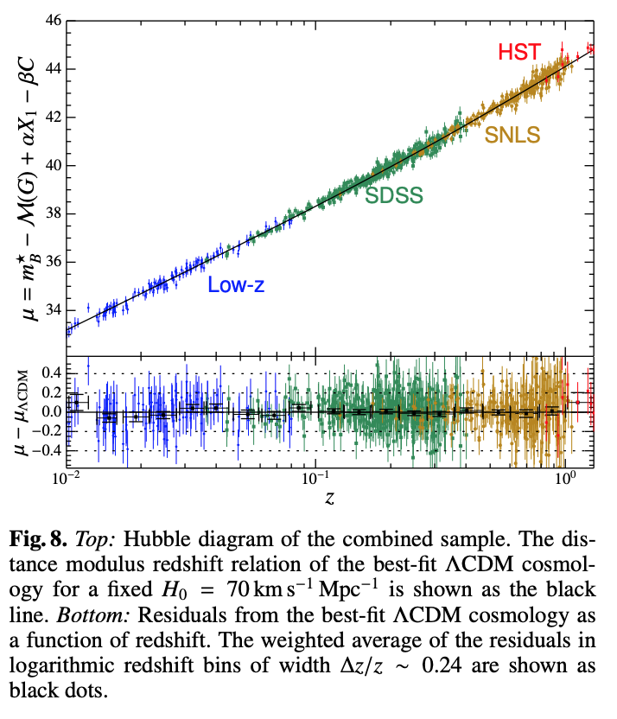
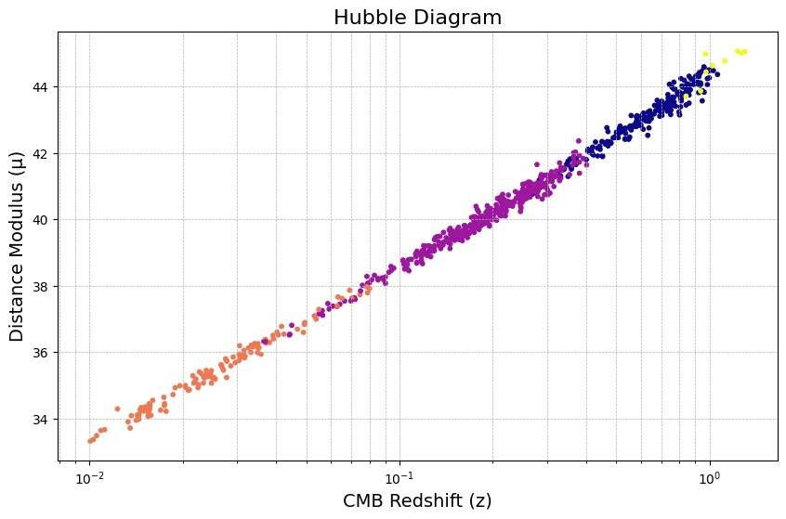
Where We Left Off Last Time

Slide 3
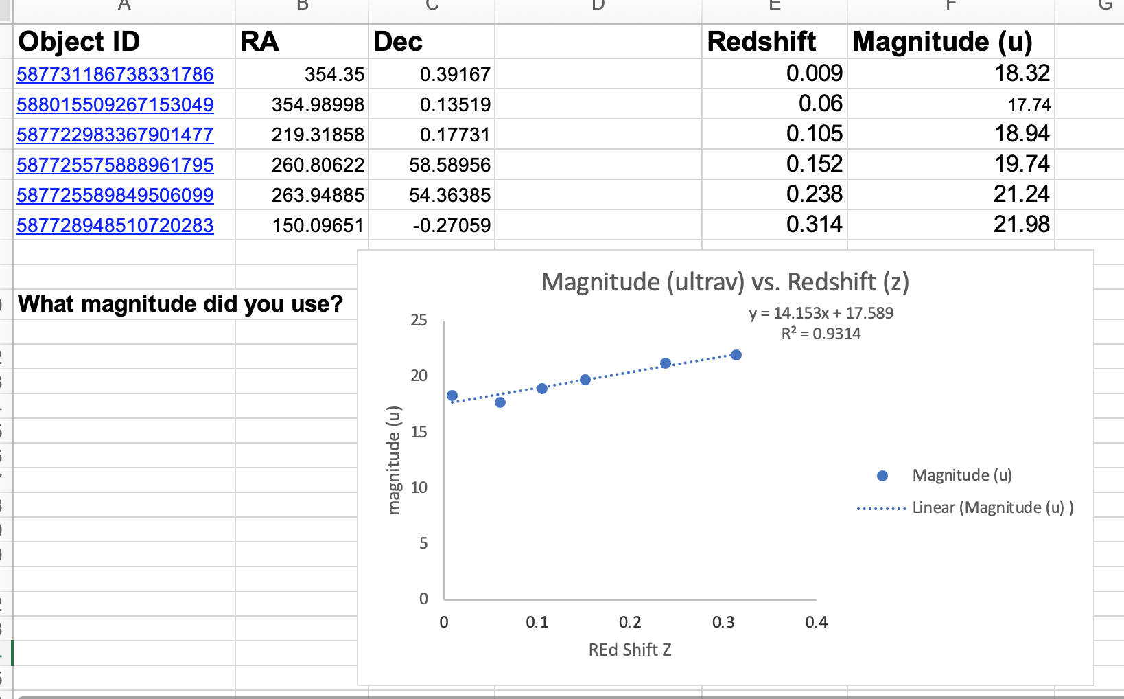
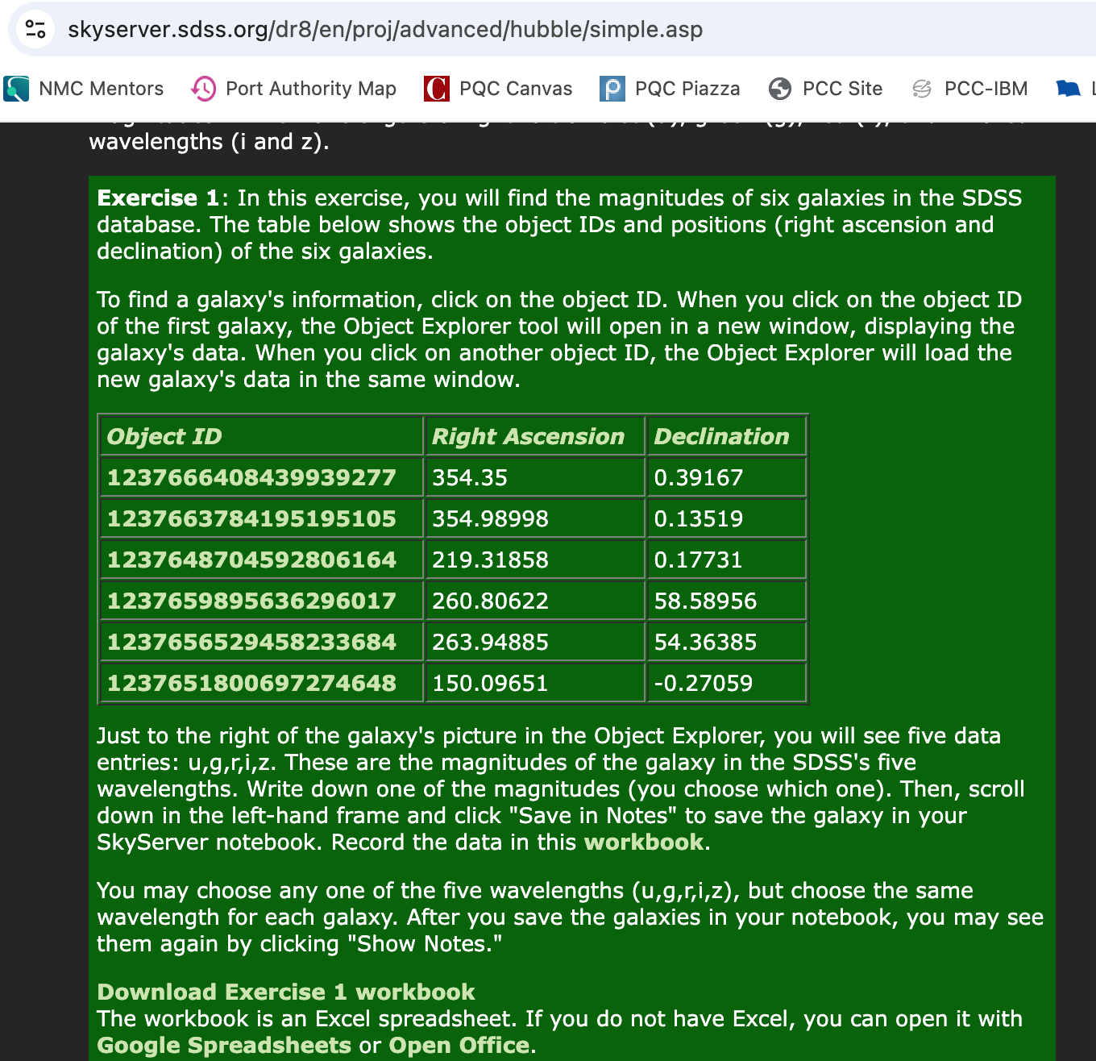
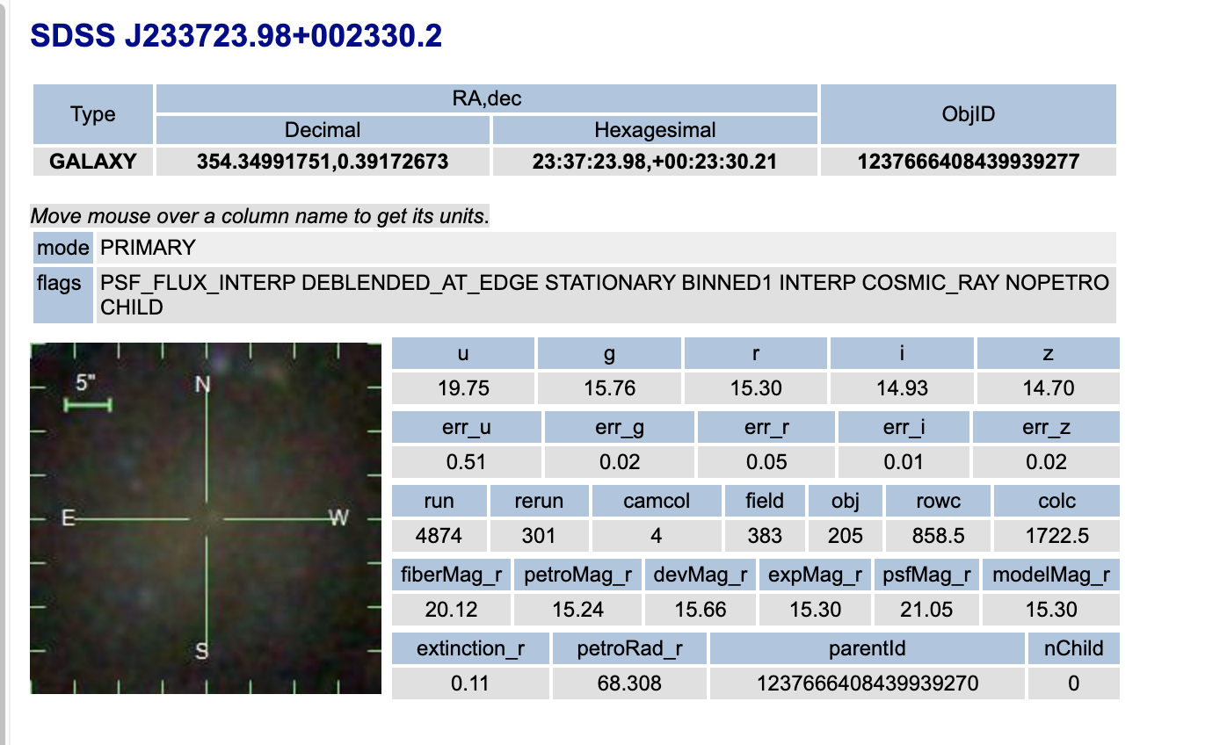
Starting Out Simple

Slide 4
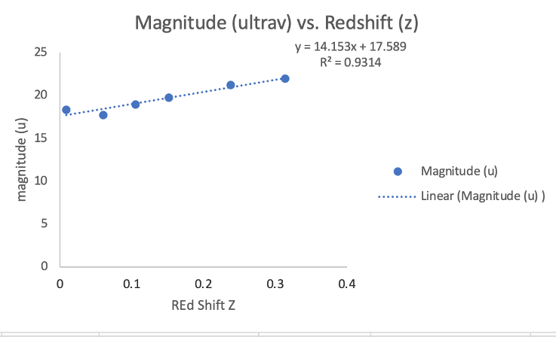
In a Simple Case
Magnitude is inversely related to brightness of an object.
Lower u, brighter object.
The brighter (closer) supernovae are moving away slower than the ones that are further away.
But there’s Lots of things we have to account for. Data has to be treated.

Slide 5
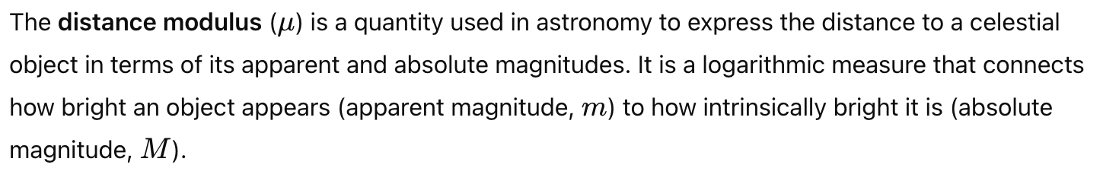
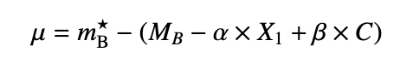
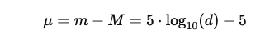
In Paper - Distance Modulus
Apprant magnitude – the brightness of the object as it appears on earth. Absolute Magnitude – (i.e. intrinsic brightness of an object) how bright it would appear when placed a distance of 10 parsecs from the earth observer.
Distance – Measured in Parsecs
Difference between apparent magnitude and absolute tells the distance object is from earth. 10 parsecs being the ”reference pt.”

Slide 6
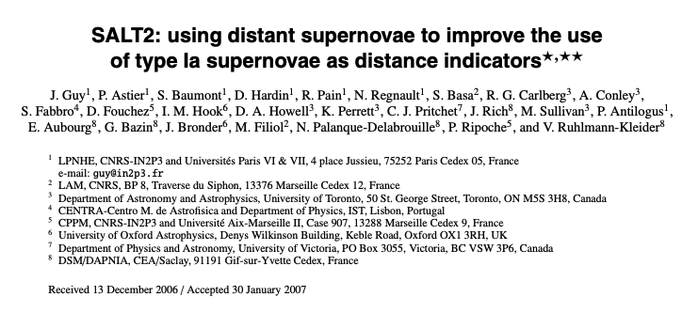
SALT 2 Model - Rest Frame Blue Band (b-band) Magnitude
Light Curve Data (ugriz over time) for Individual Ia SNA -> SALT2 Model –> mb* extracted.
“Rest Frame” – unaffected by expansion of universe.
Purpose: Standardization, B band observes main process behind SNA exp. explosion.

Slide 7
Absolute Magnitude (Mb) of Type Ia SNA
Determined from Type Ia supernovae usually from nearby galaxies and always with already established distances (using some other ofrm of measurement).
Used as a “candle” standard reference.
Host Galaxy property.

Slide 8
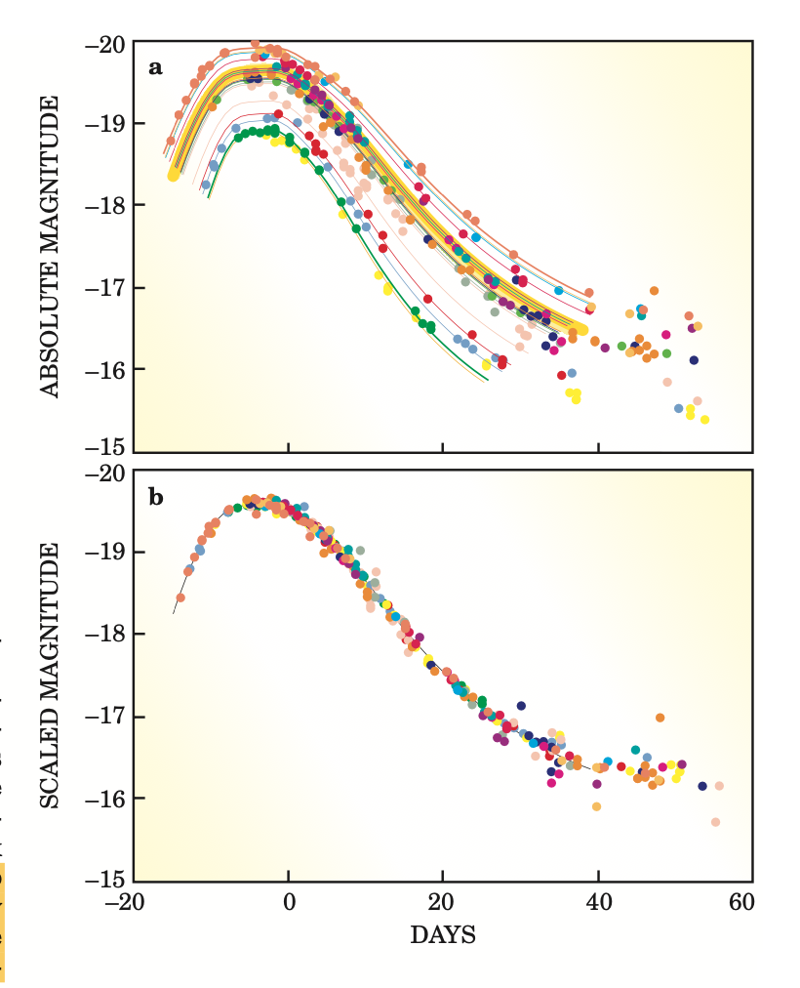
Stretch
X1 calculated for each light curve.
Broader light curves have higher luminosity (i.e. brightness) and narrower have lower. This could give false readings of distance modulus.
X1 is a measure of how broad or narrow light curve is.
Alpha is a model determined constant that dictates how much this stretch/narrow affects the distance modulus.

Slide 9
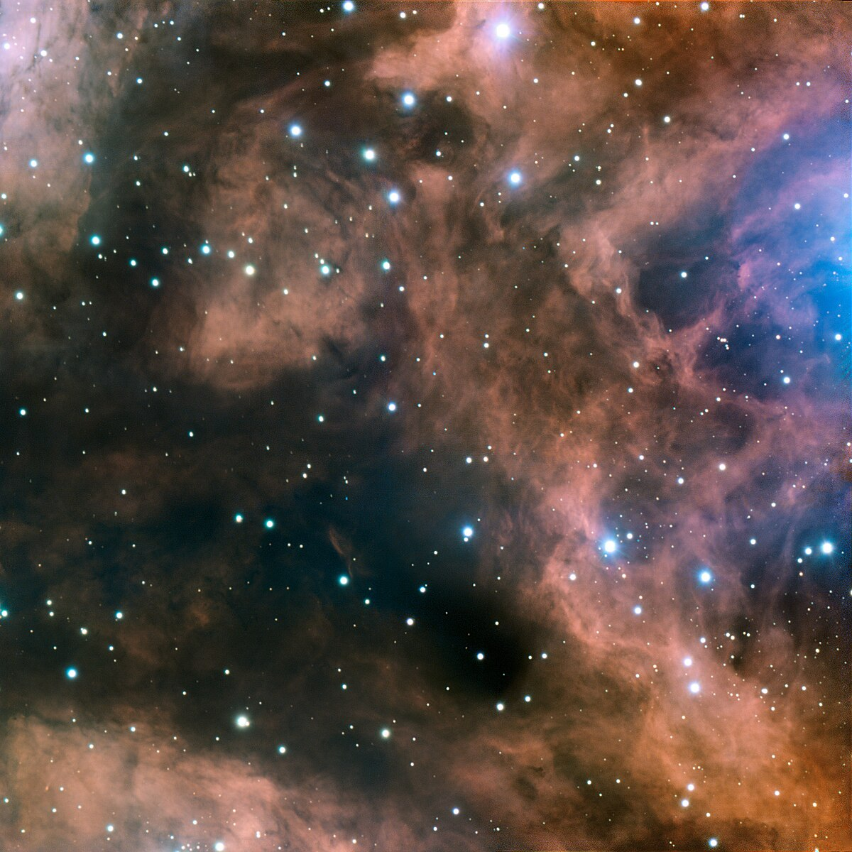
Correcting 4 Dust (a.k.a. color):
NOTE: B-Band sensitive to dust.
If C > 0 there is dust in between SNA and observer.
If C < 0 there is less dust than usual.
Beta is a model determined constant that dictates how much this bright/dim effect affects our parameters.
B -> Host galaxy property.

Slide 10
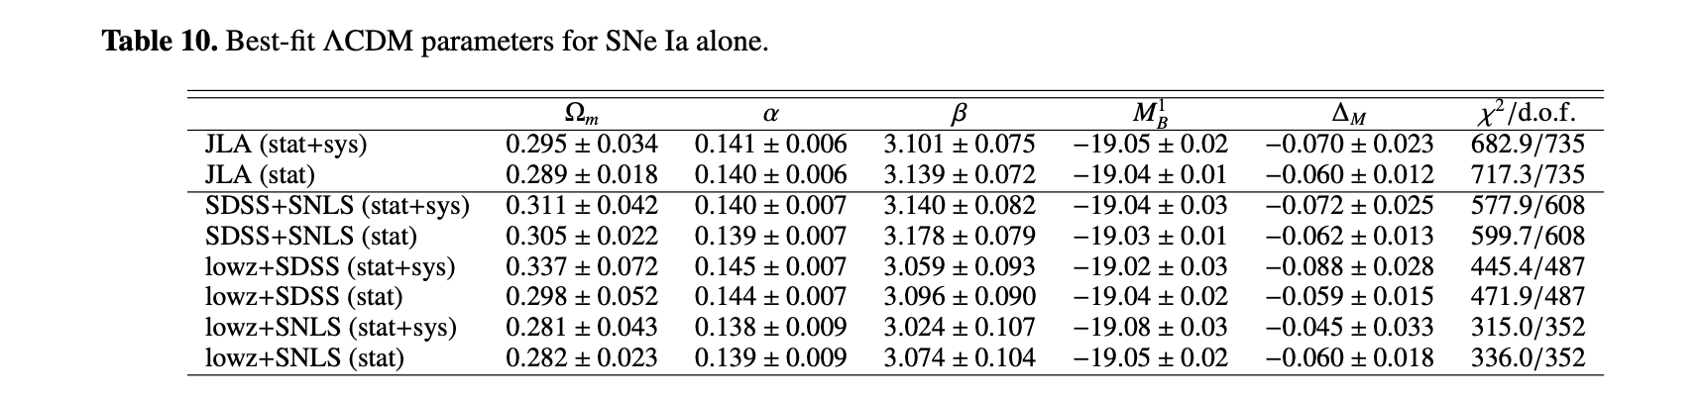
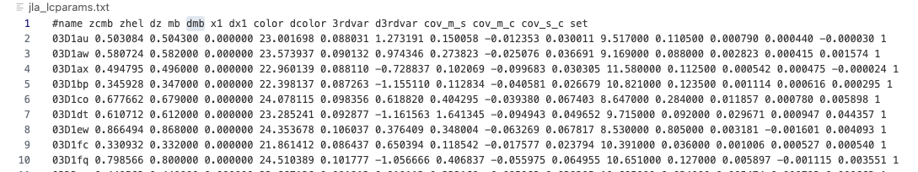
Summary of Conceptual Understanding
Different for each Ia Sna, also results of model fitting. Giving in JLA dataset.
Constants Result of Model (ex. SALT2) and Given in Paper

Slide 11
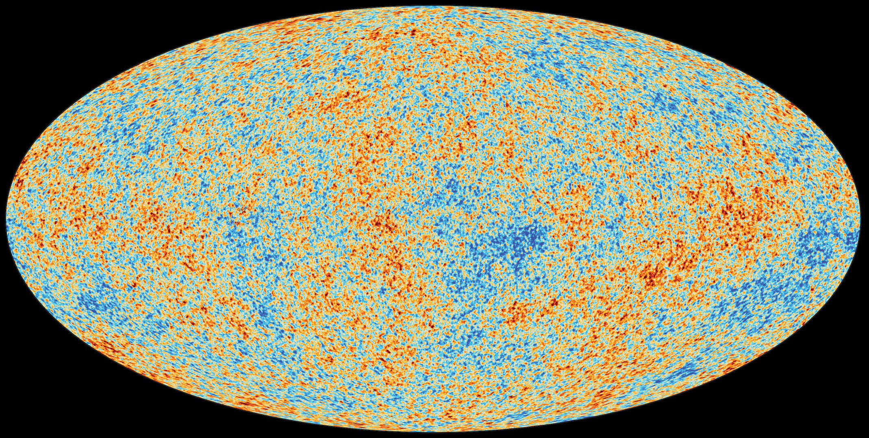
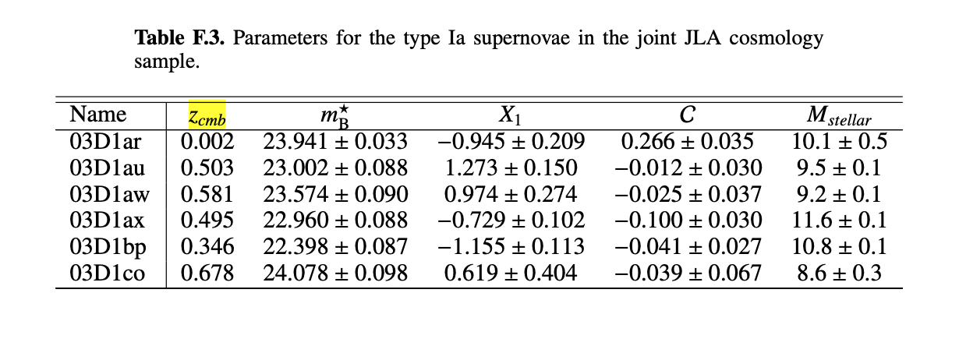
Cosmic Microwave Background z: (z_{cmb})
Standard practice in hubble diagrams is to use z_{cmb}
Determined by taking heliocentric redshift (i.e. what we observe from earth) and removing the influence of motion of earth, sun, and our milky way galaxy.
In this particular survey: its especially important to use Zcmb because the data is collected from multiple surveys (i.e. points of observation).
Fun fact: cosmic microwave background expands with the universe.

Slide 12
Putting it All Together – Hubble Diagram
NOTE: Missing Uncertainties.

Slide 13
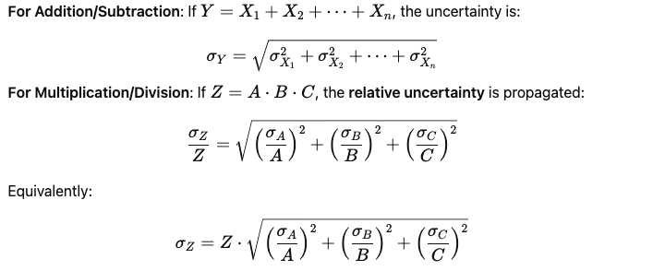
Uncertainty Propagation Background +/x
Every Variable on the RHS of the equation is presented with its own uncertainty. How to find uncertainty in mu?

Slide 14
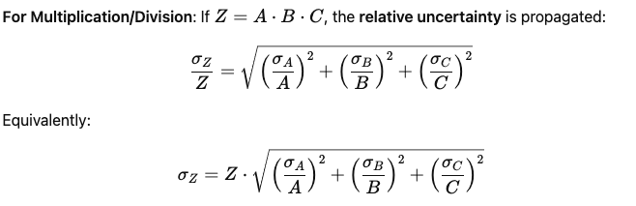
Uncertainty Propagation Addition
Uncertainty propagation Rules (Multiplication):

Slide 15
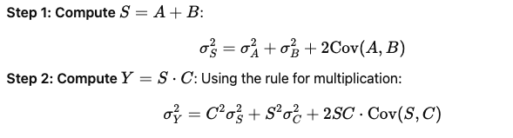
Uncertainty Propagation Covariance
Covariance: some of the variables (and associated physical effects) change together. So uncertainty propagation ends up being:

Slide 16
Error Propagation for mu:
NOTE: Missing MB uncertainty contribution

Slide 17
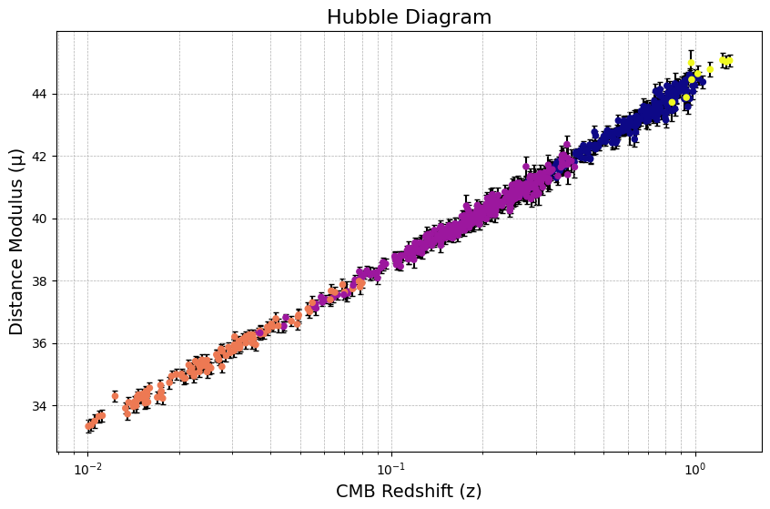
Hubble Diagram with Uncertainty

Slide 18
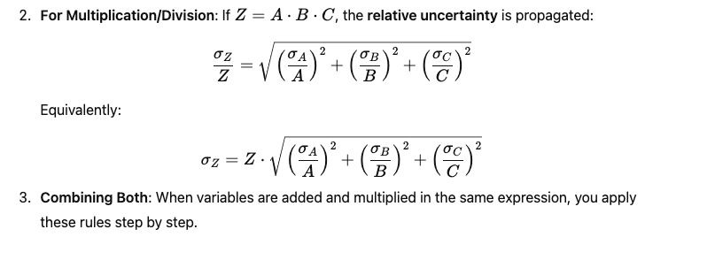
Uncertainty Propagation Multiplication

Slide 19
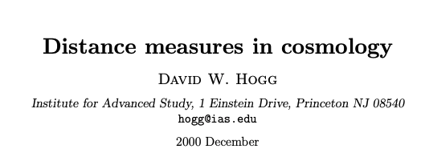
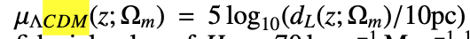
Future Work: Theoretical model – ΛCDM
Model of the Big Bang Theory that accounts for dark energy (lambda).
Can be use dot model the distance modulus having to account for dark energy.
From the paper:

Slide 20
Supplement/Reference
https://supernovae.in2p3.fr/sdss_snls_jla/ReadMe.html#sec-3

